Slide 1
E-Commerce Project
Team 18
Section IS3

Slide 2
Team Member :
Abd Elrahman Hassan Mohamed Hassan
Taher Mahmoud Sayed
Omar Ayman Mahfouz
Ali Zaki Ali Shahat
Abd Elrahman Sabet
Github link
https://github.com/AbdelrahmanElhawary/laravel-projects

Slide 3
Each one Role
Design
Abd Elrahman Hassan.
Omar Ayman.
Database
Ali Zaki Ali Shahat.
Taher Mahmoud Sayed.
Abd Elrahman Sabet.
Abd Elrahman Hassan.
Link All Things
Abd Elrahman Hassan Mohamed

Slide 4
overview
We focused on the design/database in the same time .
So about 70% of the database side is finished
And unfortunately same goes to the design , because it’s not finished completely
It’s just basic design to test the database/relation/validation etc…
Add/edit/remove product/category Are almost finished form database side , And works just fine
For testing
the admin email: admin@yahoo.com ,pw:123456789
The user email: user1@yahoo.com,pw:123456789

Slide 5
Overview cont.
Since there is only one admin we added him from the developer side (i.e. using tinker)
We just modified the created user table from laravel by adding 1 colum Boolean called admin default = 0.
We changed it to 1 for the admin using tinker

Slide 6
Pages
Admin side
Dashboard (shows all categories for admin)
Show (it shows the products of a chosen category)
Products
Create (create product form)
Edit (edit product form)
Finished (products that are out of stock)
Category
Create (create Category form)
Edit (edit Category form)
User side
Home (shows all categories for user)
UserShow (it shows the products of a choosen category)
Cart (what the user bought so far)

Slide 7
Admin Pages Screens

Slide 8
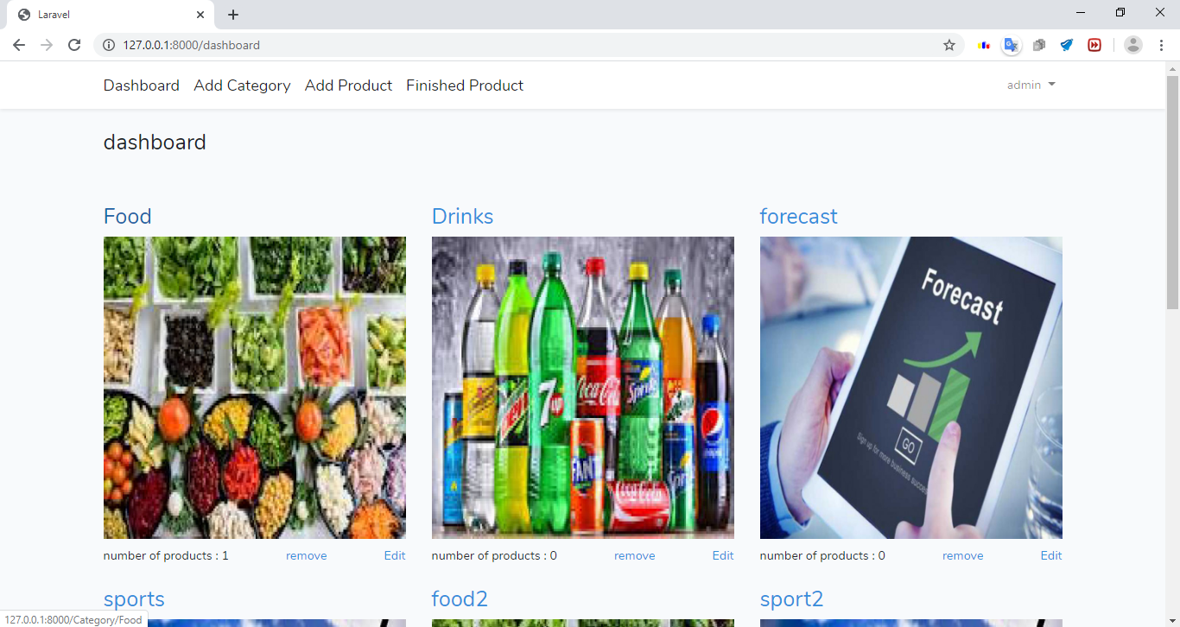
Dashboard with categories shown to the admin, with the option to add/edit/remove category
Add product
Show out of stock products

Slide 9
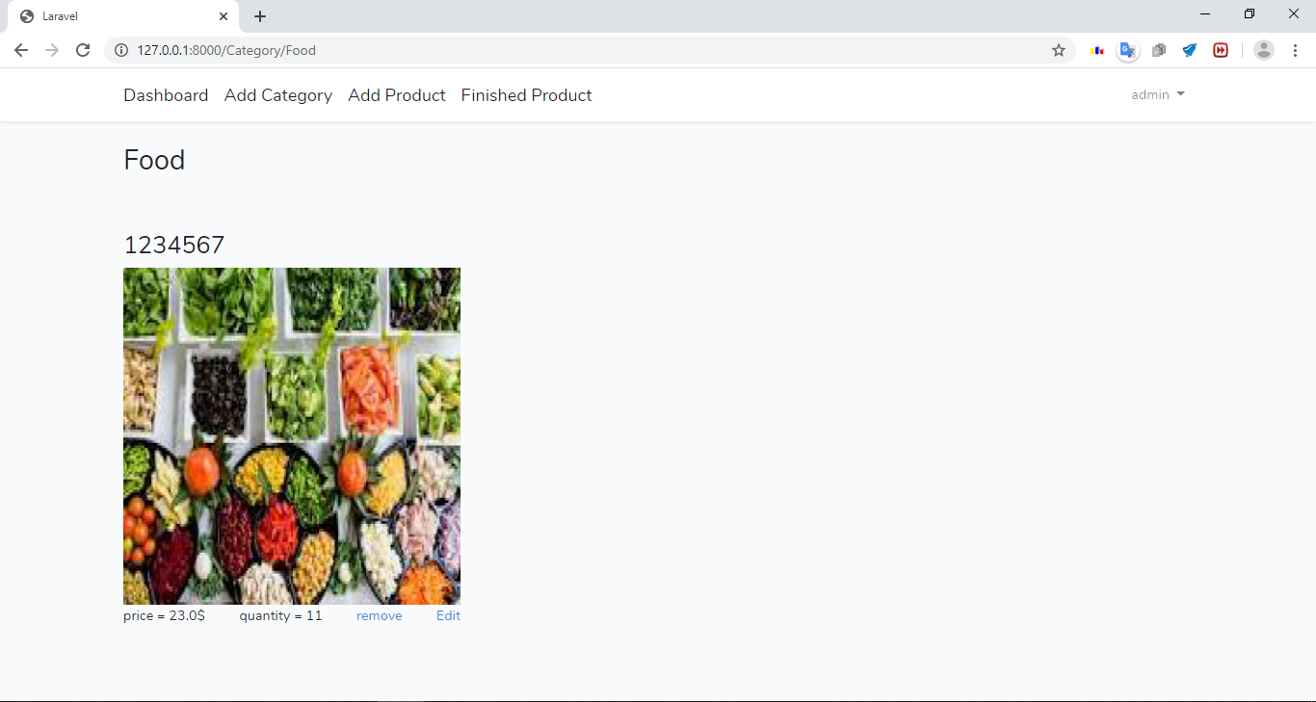
After selecting the food category
A view shows the food products
With the option to add/remove/edit product

Slide 10
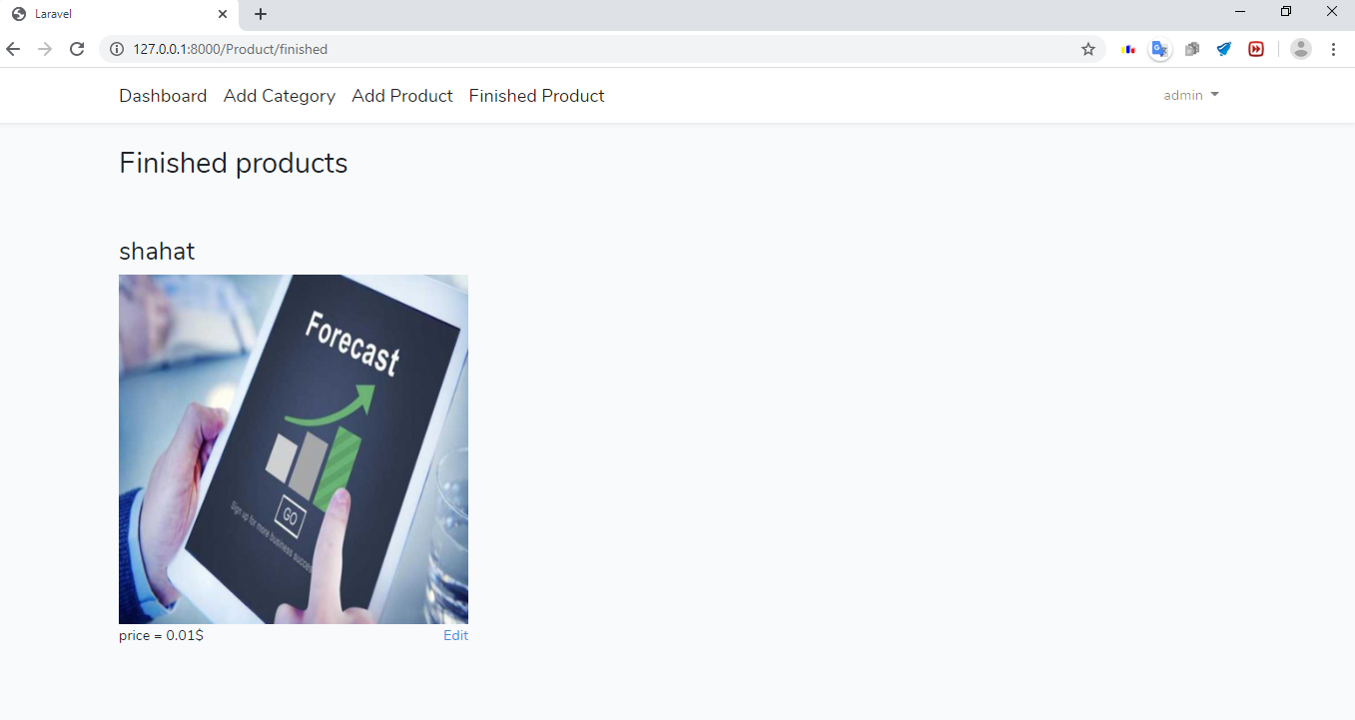
The out of stock products that its quantity reached 0

Slide 11
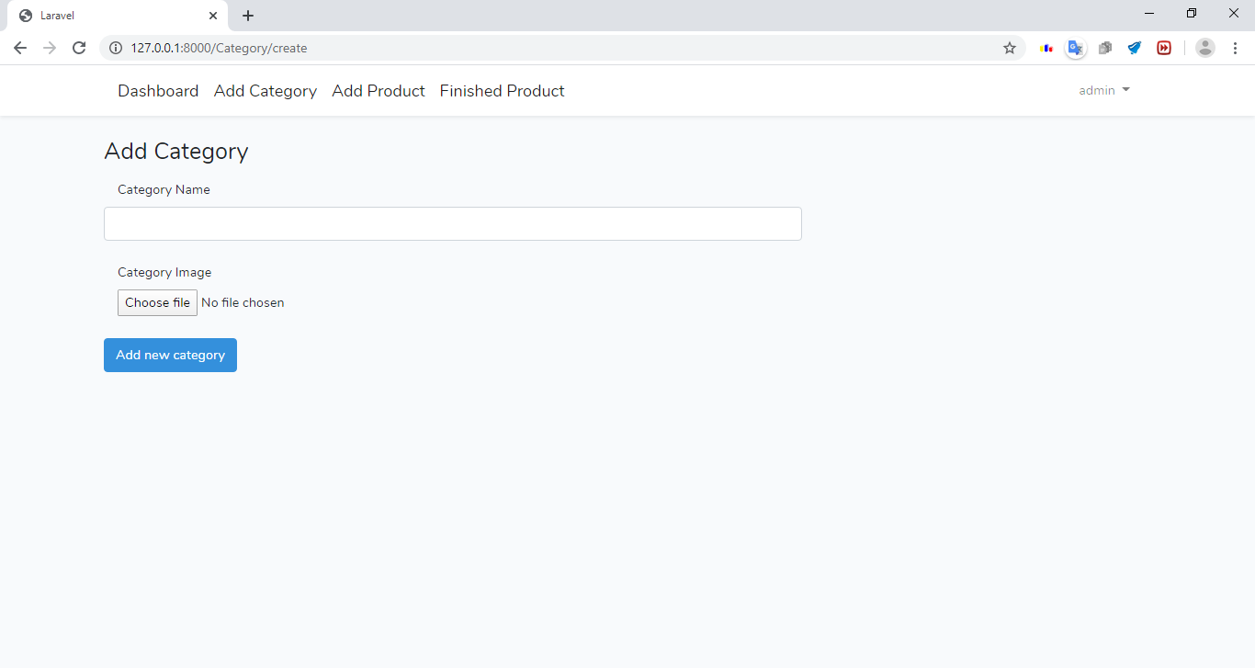
Add category form

Slide 12
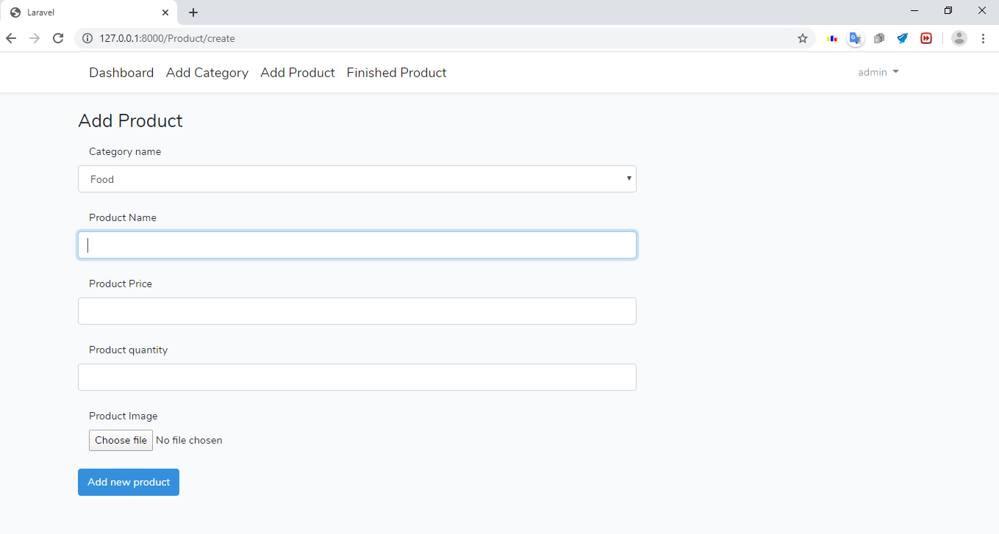
Add product form

Slide 13
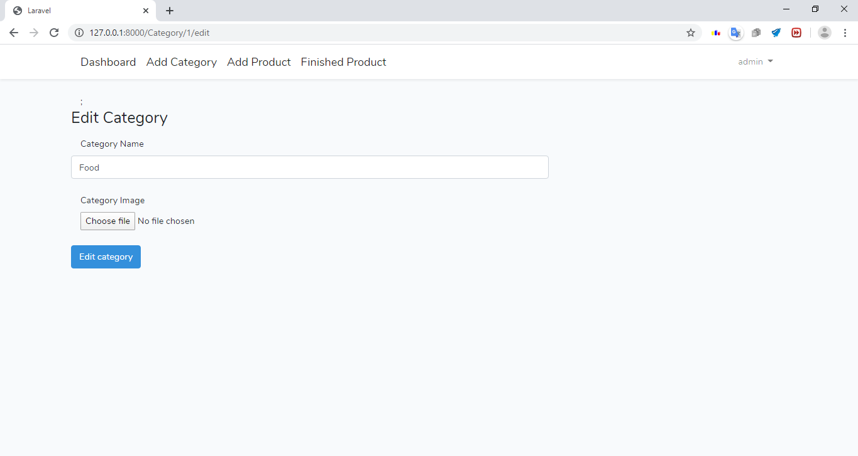
Edit category form

Slide 14
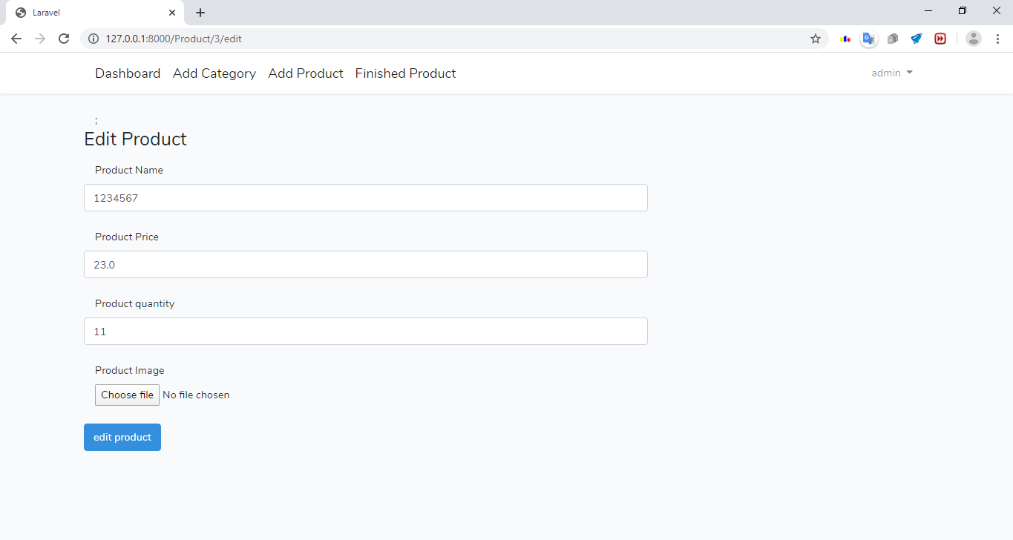
Edit product form

Slide 15
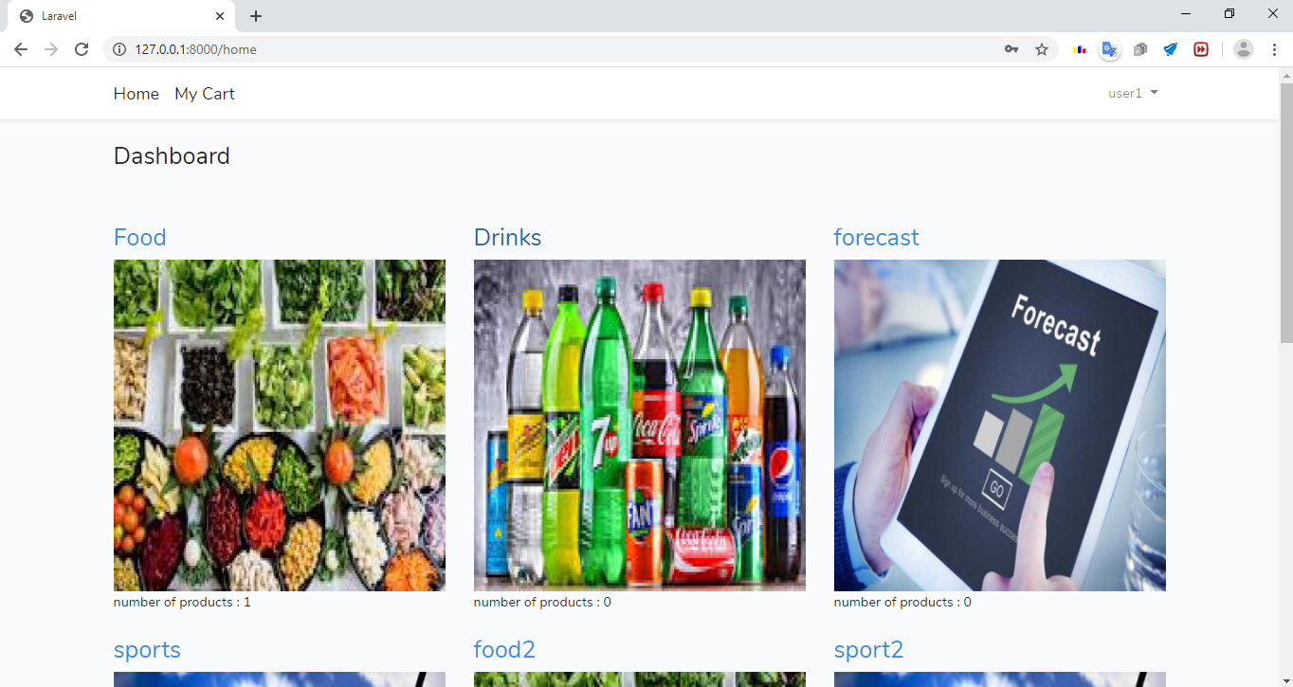
Home page for user

Slide 16

After choosing the food category , a page with the category name food appear with it’s products displayed

Slide 17
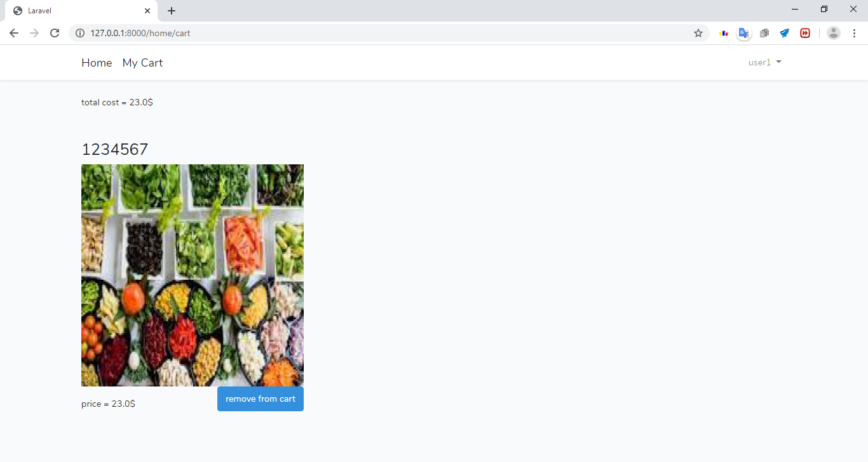
My cart with the products I bought , total cost and whether I want to remove a product or not

